Slide 1

Fake News Detection A deep learning CNN-RNN hybrid model
Pavankumar Pendela
ppendela@kent.edu
81174790

Slide 2
Introduction
Internet is full of information/news/tweets/post/articles.
No tool/mechanism to differentiate the fake and genuine.
Deep learning model can be created to filter fake news.
Convolutional-concurrent Hybrid approach is followed by us.
This Model is the hybrid network which is a combination of convolutional neural networks and recurrent neural networks.
As this model is required to classify between fake news and legitimate news, so this problem is cast as a binary classification problem.
Deep learning techniques have great prospect in fake news detection task.

Slide 3
Dataset used
Taken from Kaggle.
https://www.kaggle.com/c/fake-news/data?select=submit.csv

Slide 4
Preprocessing
Delete rows with missing values.
Dataset=dataset.dropna()
Splitting dataset into (training, testing) and validating.
X=dataset[‘text’].values[:n]
Y=dataset[‘label’].values[:n]
X and Y are divided into train and test set.
X_train, x_test, y_train, y_test=train_test_split(x,y,testsize=.25)
X_valid=dataset[‘text’].values[n:]
Y_valid=dataset[‘label’].values[n:]

Slide 5
Preprocessing. Contd.
Training=60%, validation=20% and testing=20%
Tokenizing the training set.
Tokenizer=Tokenizer(num_words=100000)
Tokenizer.fit_on_texts(x_train)
Converting text to sequences.
x_train=tokenizer.texts_to_sequences(x_train)
x_valid=tokenizer.texts_to_sequences(x_valid)
x_test=tokenizer.texts_to_sequences(x_test)

Slide 6
Preprocessing contd.
Pad sequencing.
X_train=pad_sequences(x_train, padding=‘post’, maxlen=400)
X_valid=pad_sequences(x_valid, padding=‘post’, maxlen=400)
X_test=pad_sequences(x_test, padding=‘post’, maxlena=400)
Word_index is the name of vocabulary. It is a dictionary.
Word_index={Word: index, ‘the’:1}
|word_index|=100000
Every word of x_train, x_valid and x_test is replaced by their index in vocab.
Every text is of same size = 400

Slide 7
What is CNN?
It is deep learning neural network.
CNN stands for convolutional neural network.
This networks consists of 3 layers.
1st layer: Convolutional layer, it extracts simple features from the input like edges.
2nd layer: Pooling layer, it reduces the dimension of the output of convolutional layer.
3rd layer: Activation layer, we use ‘relu’. This used to convert the negative values into 0.
So, CNN: convolution -> pooling -> activation

Slide 8
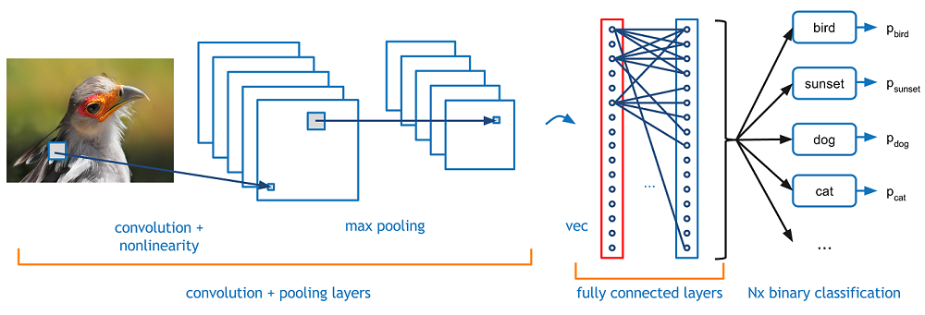
CNN

Slide 9
What is RNN?
It is deep learning neural network.
Recurrent Neural Network is a generalization of feedforward neural network that has an internal memory.
For making a decision, it considers the current input and the output that it has learned from the previous input.
Unlike feedforward neural networks, RNNs can use their internal state (memory) to process sequences of inputs.
This makes them applicable to tasks such as unsegmented, connected handwriting recognition or speech recognition.
In other neural networks, all the inputs are independent of each other. But in RNN, all the inputs are related to each other.

Slide 10
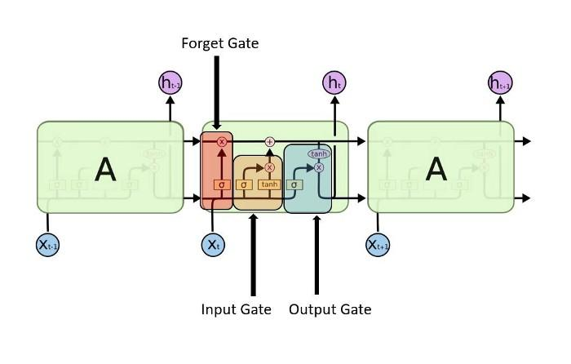
What is LSTM?
It is modified version of RNN.
It mitigates the problem of vanishing gradient of RNN.
It trains the model by using BPN.
In an LSTM, 3 gates are present.

Slide 11
Hybrid CNN-RNN.
The proposed model makes use of the ability of the CNN to extract local features and of the LSTM to learn long-term dependencies.
First, a CNN layer of Conv1D is used for processing the input vectors and extracting the local features that reside at the text-level.
The output of the CNN layer (i.e. the feature maps) are the input for the RNN layer of LSTM units/cells that follows.
The RNN layer uses the local features extracted by the CNN and learns the long-term dependencies of the local features of news that classify them as fake or real.

Slide 12
Model
Embedding layer
Convolutional layer: 128 neurons, filter size = 5
Pooling layer: filter size = 2
LSTM layer: 32 cells
Dense layer: 1 neuron
Optimizer: adam
Loss: binary_crossentropy
Metric: accuray

Slide 13
Training
Training set: x_train, y_train
Epochs= 10 & 12
Validation set: x_valid, y_valid
Batch_size = 64
Training time= 15 minutes.

Slide 14
Saving the model
Model.save(‘my_model.h5’)
Pickle the history
Pickle the x_test and y_test.
Pickling: create a new pickle file with writing mode.
Dump function is used.

Slide 15
Testing
The saved files are loaded: history, x_test, y_test, model.
Model is tested against x_test and y_test.
Performance measure:
Confusion matrix
Classification report
Accuracy= approx. 95% for 3 different executions.

Slide 16
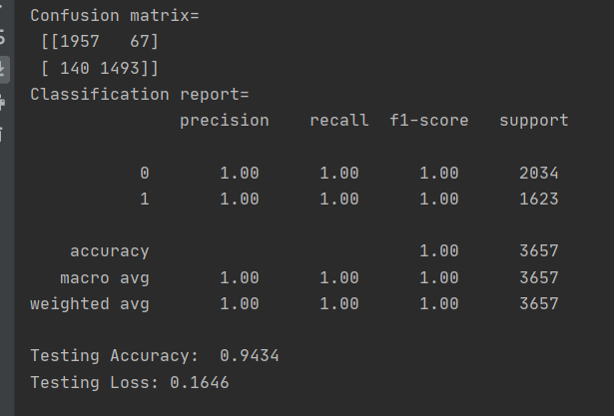
CM & CR

Slide 17
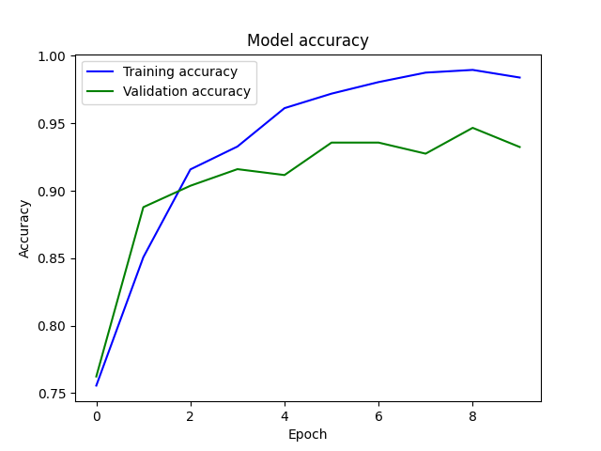
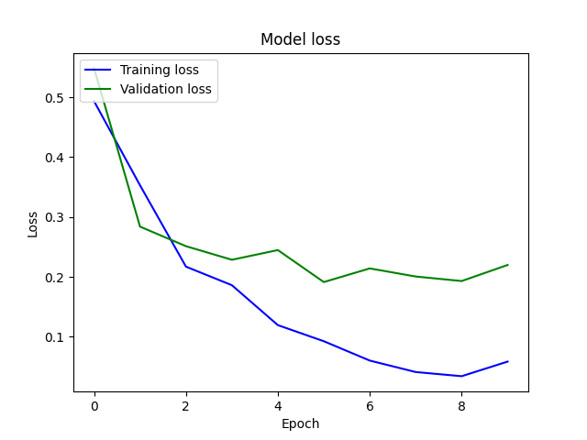
Output of execution_1

Slide 18
.
THANK YOU

